Slide 1
Good practice in Research Data Management
Module 4: Data management planning

Slide 2
Topics
Data management good practice
Data management planning
Data sharing and reuse

Slide 3
Data management good practice

Slide 4
Data Management fundamentals
Good data management is fundamental
For research excellence
For high quality data
For data sharing, replication and reuse
For sustainability
For long-term sustainability and accessibility
For data security
For reputational benefit

Slide 5
Backup, security & archiving
Two important requirements of data management:
Backing up your data securely
Consideration for your archiving requirements

Slide 6
Backup and security
Backup refers to your 'live' or 'working' data
Essential to reduce the risk of losing data through accidental deletion or hard-drive failure
Security refers to keeping your data safe
Essential for controlling access and avoiding corruption or misuse
ISS guidance re. security
http://www.ncl.ac.uk/itservice/security/

Slide 7
Storing data
Should be taken seriously from the start of research
For both digital and non-digital data
Data processing and short term storage should be written into the research data plan
End point storage and archiving dependent on the nature of the data and funder requirements

Slide 8
Data storage: key considerations
UK Data Archive recommends considering:
What data or file formats should I use to store data?
What kind of documentation or metadata do I need to accompany stored data?
What storage media should I choose?
What physical conditions do I need to provide for storing data?
How do I ensure my data are stored under adequate security?
How should I store confidential data?
http://www.data-archive.ac.uk/create-manage/storage/store-data

Slide 9
Data sharing
Approaches vary, depending on:
research environment and discipline
funder requirements
Multiple routes to sharing research data, including:
depositing with a specialist data centre, data archive or data bank
submitting them to a journal to support a publication
depositing them in an local research group or institutional repository
making them available online via a project or institutional website
making them available informally between researchers on a peer-to-peer basis

Slide 10
Why share data?
Benefits to
Researchers
Funders
Public
Research community
Research participants

Slide 11
How to share data
Use appropriate repositories
http://databib.org
License the data so it's clear how it can be reused
http://www.dcc.ac.uk/resources/how-guides/license-research-data
Offer clarity re. how to cite the data
http://www.dcc.ac.uk/resources/how-guides/cite-datasets

Slide 12
Data documentation
Sufficient contextual information is required to make sense of the data, explaining:
how data were created or digitised
what data mean
what their content and structure are
any data manipulations that may have taken place

Slide 13
Data management planning

Slide 14
Data Management Plans (DMPs)
DMPs "typically state what data will be created and how, and outline the plans for sharing and preservation, noting what is appropriate given the nature of the data and any restrictions that may need to be applied"
http://www.dcc.ac.uk/resources/data-management-plans

Slide 15
Funder requirements
http://www.dcc.ac.uk/resources/policy-and-legal/overview-funders-data-policies

Slide 16
Five common themes across funders
Description of data to be collected/created
Standards/methodologies for data collection & management
Ethics and Intellectual Property
Plans for data sharing and access
Strategy for long-term preservation
Notes:
16

Slide 17
What are funders looking for?
Reassurance!
"resources to support great data management for great science"
One expert voice will persuade the committee
Concision and specific information
http://www.youtube.com/watch?v=7OJtiA53-Fk

Slide 18
Why develop a DMP?
DMPs help you to properly manage your data for your use, meet funder needs & enable sharing
i.e. they're useful whenever researchers are creating data
They help researchers to:
Make informed decisions
Avoid duplication, data loss and security breaches
Develop procedures early on for consistency
Ensure data are accurate, complete, reliable and secure
Plan to share data and increase impact
Notes:
18

Slide 19
Who should write the DMP?
Data management planning is a collaborative endeavour:
it should involve all members of the research team
it may also require professional support
from a data librarian
from repository staff responsible for the long term preservation and management of data
Further support and input from Research Funding Development Managers (RES)
http://research.ncl.ac.uk/rdm/policyandgovernance/governance/

Slide 20
Introducing DMP Online
Web-based tool
Launched April 2010 by the DCC
designed to help researchers and other data stakeholders develop DMPs according to the requirements of major research funders
http://dmponline.dcc.ac.uk/

Slide 21
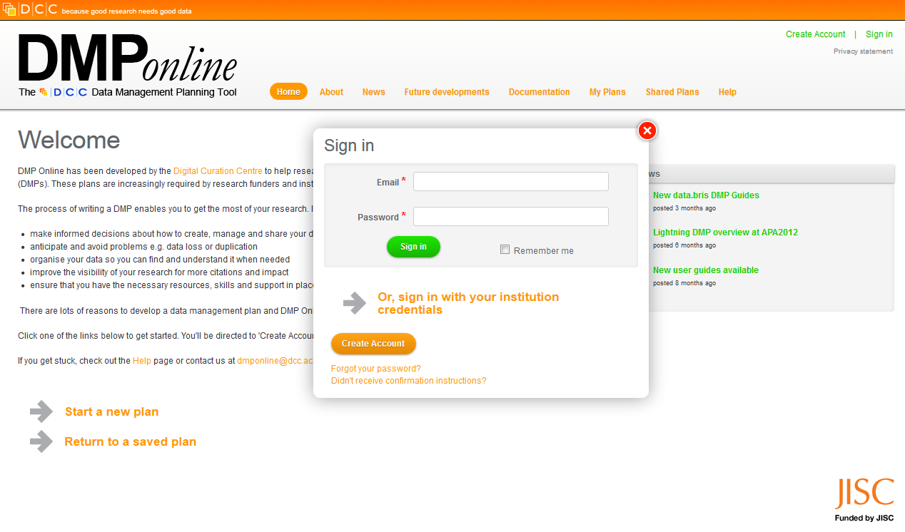
Notes:
Sign in using Newcastle University credentials

Slide 22
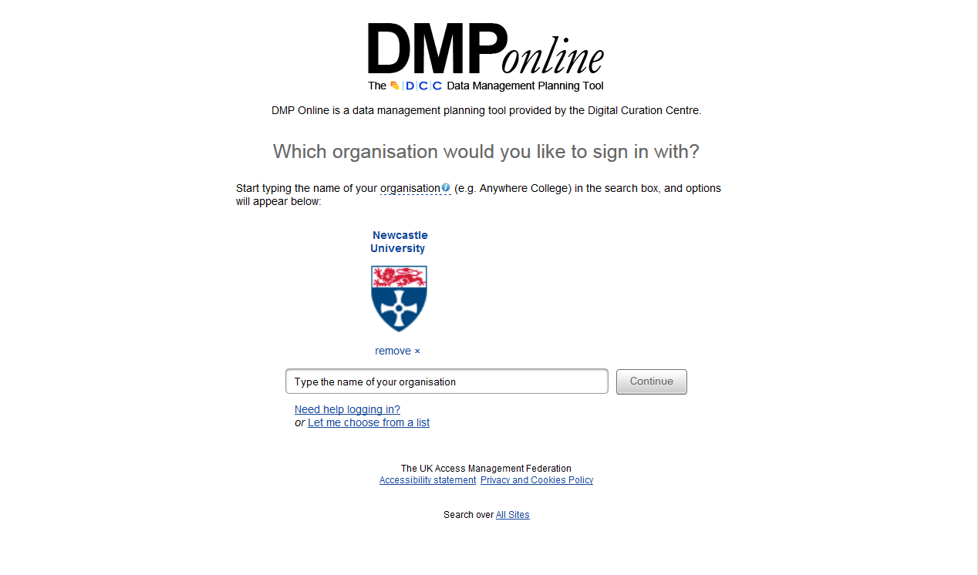
Notes:
Sign in using Newcastle University credentials

Slide 23
Notes:
Sign in using Newcastle University credentials

Slide 24
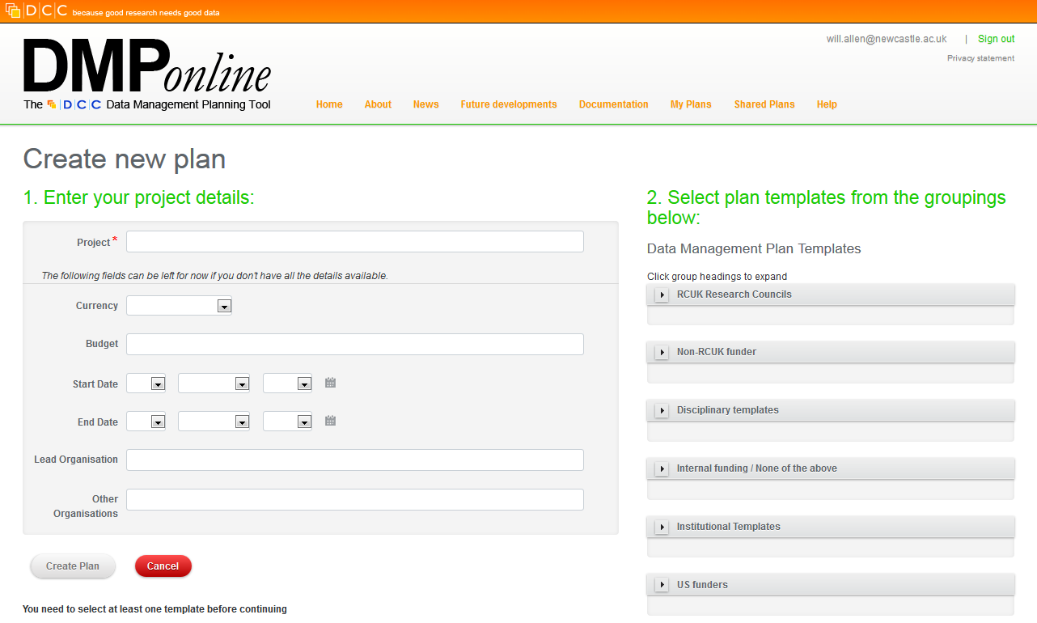
Notes:
Starting a new plan

Slide 25
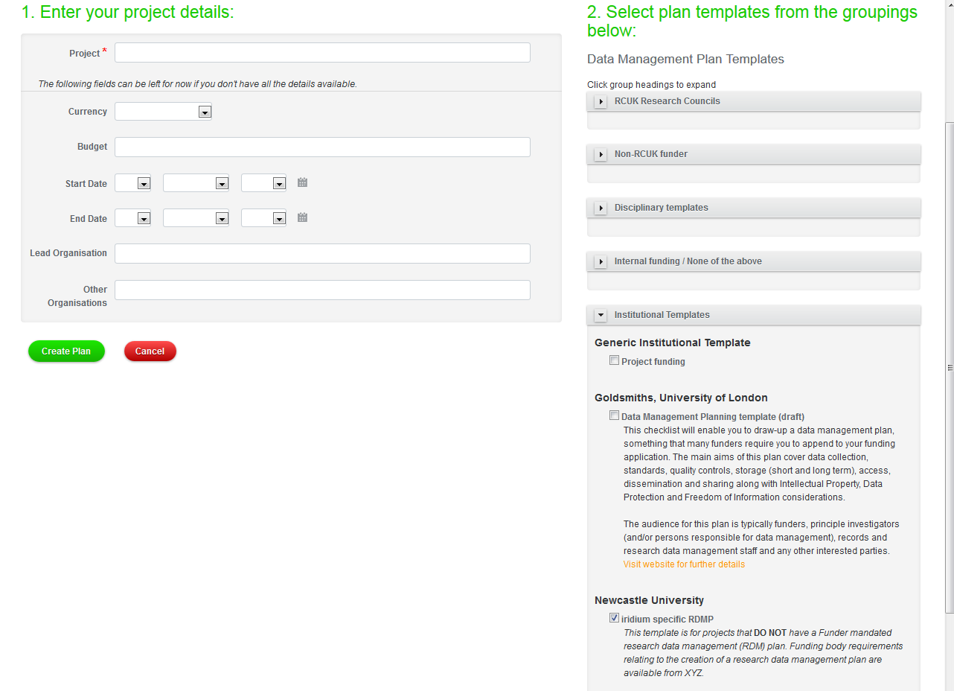
Notes:
Adding project details and selecting a template

Slide 26
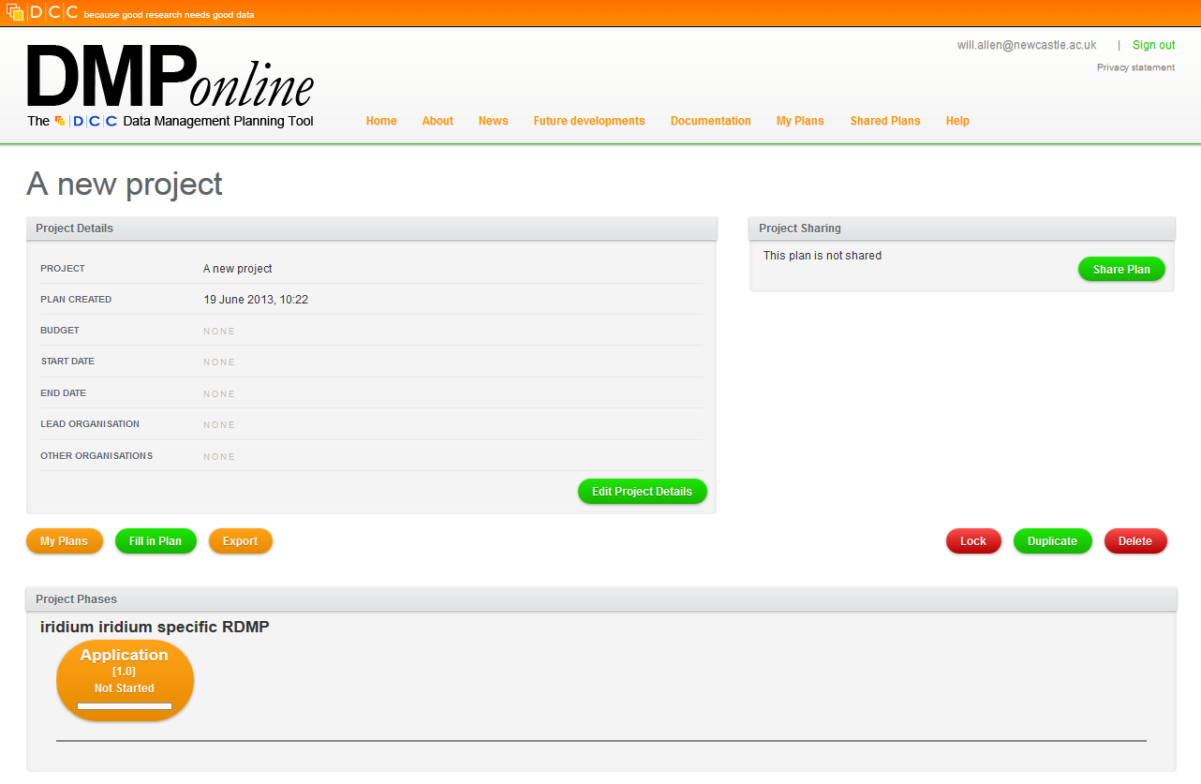
Notes:
Project overview screen

Slide 27
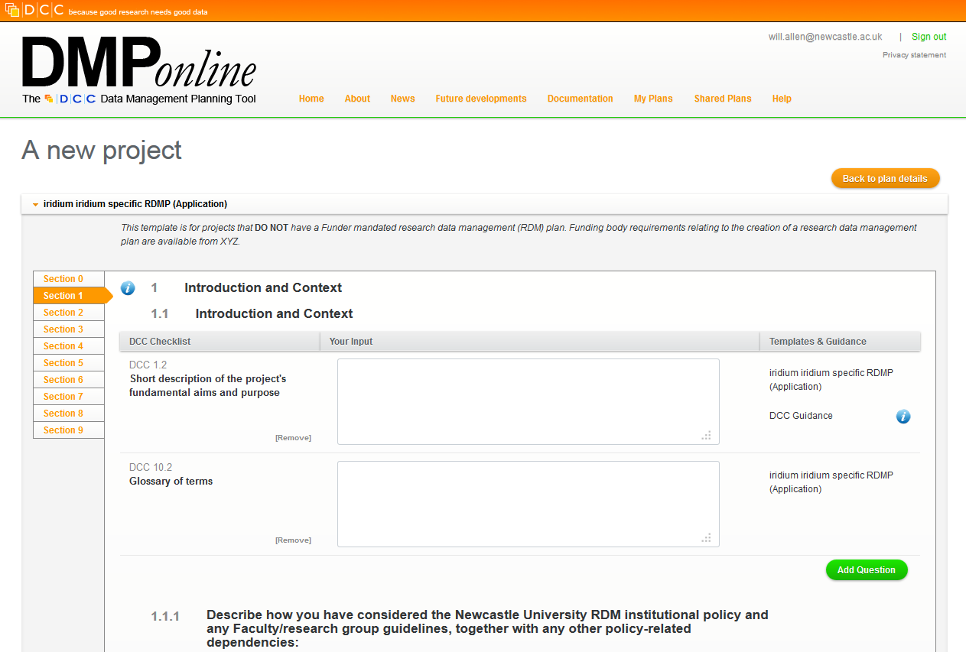
Notes:
Filling in a plan

Slide 28
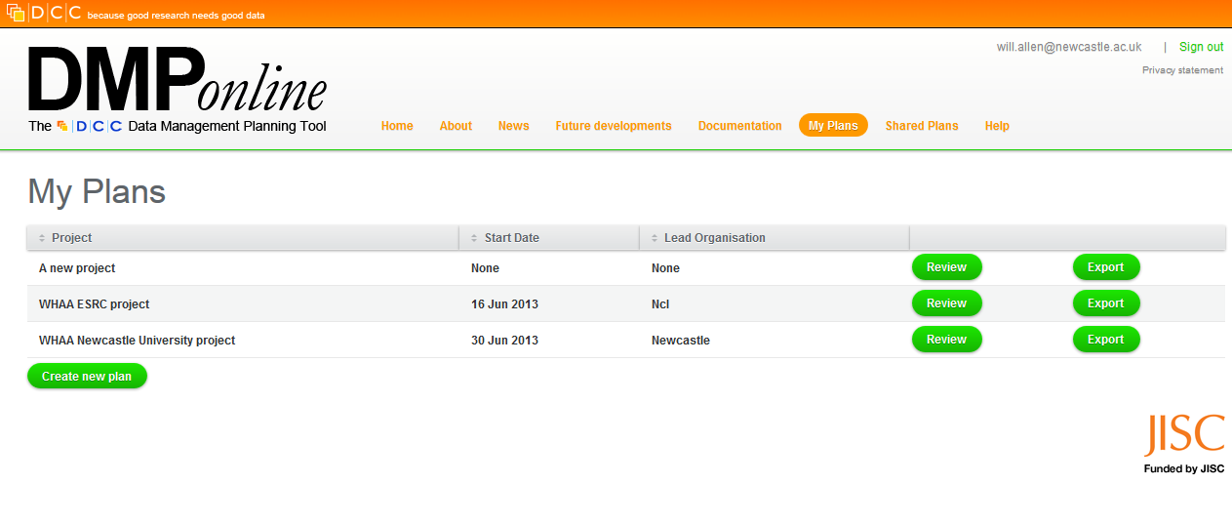
Notes:
"My Plans"

Slide 29
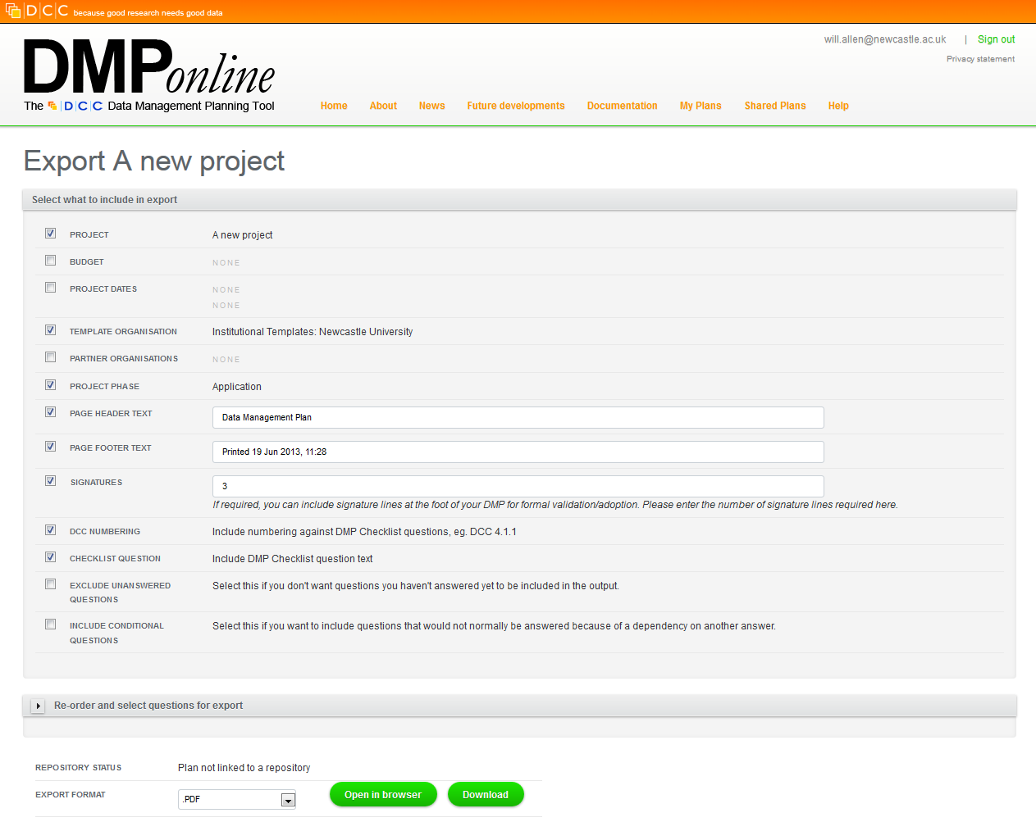
Notes:
Exporting a plan

Slide 30
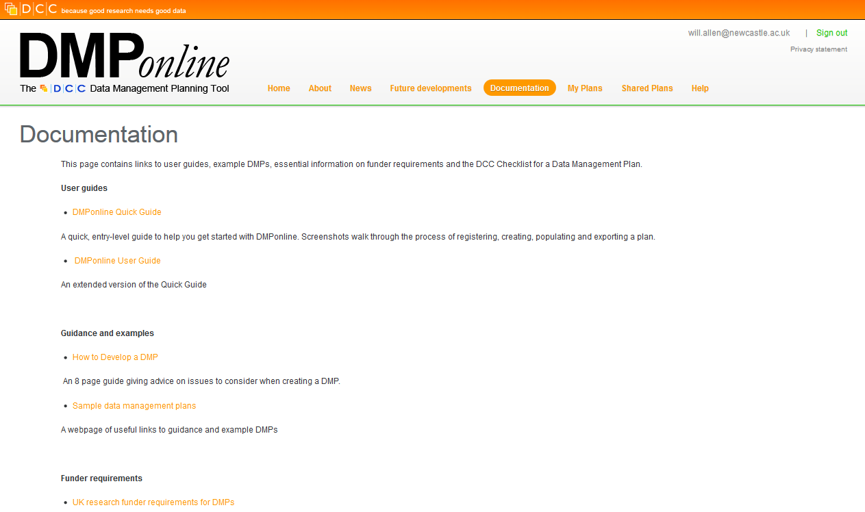
Notes:
Documentation

Slide 31
DCC checklist
Basis for DMP Online templates
Currently 118 questions(!) organised in 10 sections
Introduction and context
Data types, formats, standards and capture methods
Ethics and intellectual property
Access, data sharing and reuse
Short-term storage and data management
Deposit and long-term preservation
Resourcing
Adherence and review
Statement of agreement
Annexes

Slide 32
DMP Online templates
Funder-mandated DMP templates
RCUK, Cancer Research UK, Welcome Trust, NSF…
Newcastle-specific template
For projects not requiring funder-mandated DMP
Complies with draft DMP policy principles and code of good practice

Slide 33
Activity: Considering the Newcastle University DMP Online template

Slide 34
DMP Online: The Newcastle University template
How comfortable are you completing the Ncl DMP template?
Which sections are easy/hard to complete?
Who would you need to talk to or involve in writing the plan?

Slide 35
When to plan?
DCC recommends three versions:
Minimal plan at the conceptualisation or grant application stage
Core plan once the funding is in place covering issues up to the point of long-term management and preservation
Full plan that adds issues of longer-term data management

Slide 36
Adherence and review
The DMP should be regularly reviewed by the PI
Once started, projects tend to change!
Develop habitual good practice
Use plan as a communication tool - with partners, funders and yourself!
Funders will check adherence to DMPs at the end of the project
Make sure you know:
Who is responsible for making sure this plan is followed?
How often will this plan be reviewed and updated?

Slide 37
Resourcing
Institutions need to ensure that DMPs are costed accurately
including staff/organisational roles and responsibilities for research data management
and longer-term data management activities
Most funders will allow you to request additional funds for RDM but you need to make a good case
UK Data Archive data management costing tool:
http://www.data-archive.ac.uk/media/247429/costingtool.pdf

Slide 38
DCC advise
Keep it simple, short and specific
Seek advice - consult and collaborate
Base plans on available skills and support
Make sure implementation of the plan is feasible
Justify any resources or restrictions needed
http://www.dcc.ac.uk/resources/data-management-plans

Slide 39
Reusing data

Slide 40
Reusing data
Ever growing number of online tools and services
Consider and understand terms of published/shared data
DCC collation of advice
http://www.dcc.ac.uk/training/train-trainer/disciplinary-rdm-training/access-use-and-reuse/access-use-and-reuse

Slide 41
7 Data discovery tools
British Library Research Datasets: http://www.bl.uk/datasets
Databib: http://databib.org/
DataCite Metadata Search: http://search.datacite.org/
Figshare: http://figshare.com/
NERC data centres: http://www.nerc.ac.uk/research/sites/data/
Registry of Research Data Repositories: http://www.re3data.org/search/
UK Data Archive: http://data-archive.ac.uk/

Slide 42
Data discovery tools (1-2)
British Library Research Datasets:
http://www.bl.uk/datasets
Focused on the challenges of managing ever-increasing volumes of data, working towards its long-term preservation, and establishing standards for data citation
Databib
http://databib.org/
A searchable catalog / registry / directory / bibliography of research data repositories. Individual, discipline-specific repositories are categorised by subject area.

Slide 43
Data discovery tools (3-4)
DataCite Metadata Search
http://search.datacite.org/
A not-for-profit organisation whose aim is to establish easier access to research data on the Internet
Figshare
http://figshare.com/http://databib.org/
A free, personal, social web service which allows researchers to publish all of their research outputs in seconds in an easily citable, sharable and discoverable manner.
All data is persistently stored online under the most liberal Creative Commons licence.

Slide 44
Data discovery tools (5-7)
The Natural Environment Research Council (NERC) data centres
http://www.nerc.ac.uk/research/sites/data/
NERC hosts seven separate national data centres, each specialising in a different discipline of environmental / earth sciences data
Registry of Research Data Repositories (re3data)
http://www.re3data.org/search/
Another global registry of research data repositories, maintained by the German Research Foundation (Deutsche Forschungsgemeinschaft)
UK Data Archive
http://data-archive.ac.uk/
The UK's largest collection of digital research data in the Social Sciences and Humanities

Slide 45
Session review

Slide 46
In summary
Take a holistic view of research data
Commit to developing your data management good practice
Data Management Planning
"Plan ahead to create high-quality and sustainable data that can be shared"
UK Data Archive publication: Managing and Sharing Data, Best practice for researchers (2011)
Benefit from shared/published data

Slide 47
Acknowledgements
Digital Curation Centre (DCC)
http://www.dcc.ac.uk/
The UK Data Archive
http://www.data-archive.ac.uk/create-manage
DATUM for Health, Jisc project 2010-11, Northumbria University
http://www.northumbria.ac.uk/sd/academic/ceis/re/isrc/themes/rmarea/datum/health/
RDM Rose, Jisc project 2012-13, University of Sheffield
http://www.sheffield.ac.uk/is/research/projects/rdmrose
Research data MANTRA [online course], EDINA and Data Library, University of Edinburgh
http://datalib.edina.ac.uk/mantra/

